Slide 1

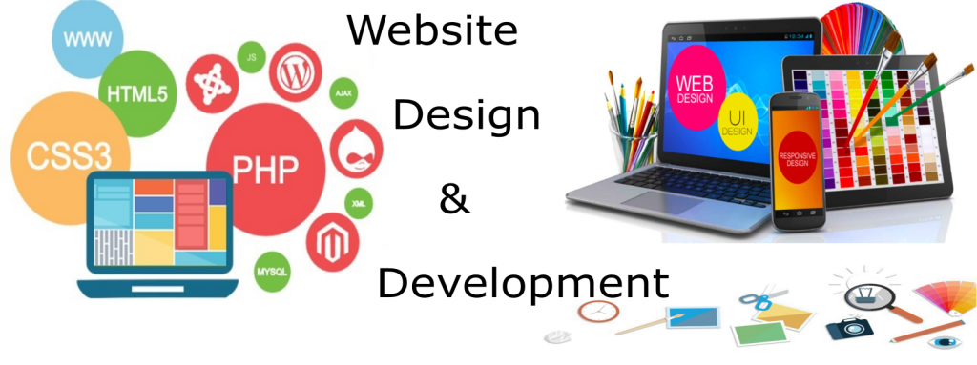
INTRODUCTION

Slide 2
Objectives
👉 What Is Network
👉 Internet
👉 Building blocks of the Internet
👉 Intranet and Extranet
👉 Uses of the Internet
👉 Web and Web Servers
👉 What happens when We access web page

Slide 3
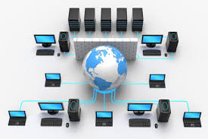
What is Network?
Network
👉 A network is a collection of computers, servers, mainframes, network devices, peripherals, or other devices connected to one another to allow the sharing of data
👉 Excellent example of a network is the Internet, which connects millions of people all over the world.

Slide 4
What is Internet?
Internet
👉 The internet is a worldwide collection of computers, servers, and networks
👉 All of computers, servers, and networks are connected together, so anyone can get access at any time.
👉 The internet is not owned or managed by any one group of people.

Slide 5
Who owns the internet?
👉 No one!
👉 Although several organizations in the world over collaborate in its functioning and development. The high-speed, fiber-optic cables (called backbones) through which the bulk of the Internet data travels are owned by telephone companies in their respective countries.

Slide 6
History of the Internet
https://www.vox.com/a/internet-maps
& http://info.cern.ch/

Slide 7
Building block of the Internet
👉 The three basic building blocks of the Internet
Packet switching
The TCP/IP protocol
Client/server computing
👉 Packet switching is a method of splitting messages up into parcels, routing them along available communications paths, and reassembling them at the destination point.
👉 The TCP/IP protocol is the set of rules that specifies how these messages should be formatted, ordered, compressed, and error-checked. The IP protocol provides the addressing scheme for the Internet
👉 Client/server computing is a computing model in which client and server computers communicate with each other over a network.
A server takes requests from client computers and shares its resources, applications and/or data with one or more client computers on the network.
A client is a computing device that initiates contact with a server in order to make use of a shareable resource.

Slide 8
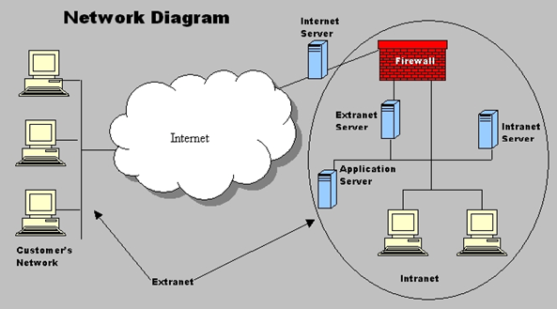
Intranet and Extranet
Intranet
👉 An intranet is a private computer network that uses Internet Protocol technologies to securely share any part of an organization's information or operational systems within that organization.
Extranet
👉 An extranet on the other hand, is formed when organizations allow outsiders to access their internal TCP/IP network.
👉 For example, a company may permit suppliers to gain access to their intranet in order to view information (like production schedules or inventory allotments) so that the suppliers will know when the company will need to restock

Slide 9
Uses of the Internet
👉 Internet is a global system that can be used for sharing information, providing worldwide services and communication.
👉 There are hardly people who do not rely on the internet for their daily life.
👉 The uses of Internet are endless; a few of them are as follows:
👉 Education
👉 Communication
👉 Current Updates
👉 Corporate Base
👉 E-Commerce

Slide 10
Web and Web Servers
Web
👉 The web is one service that is made available via the internet.
Web Servers
👉 A web server is a software
👉 The server usually is able to serve or send the web page to many users at the same time.
👉 Common web servers include apache, NGNIX, and IIS.

Slide 11



WHAT HAPPENS WHEN WE ACCESS WEB PAGE
Request-response model or Client-server architecture
CLIENT
(e.g. browser)
REQUEST
SERVER
*
RESPONSE

Slide 12


WHAT HAPPENS WHEN WE ACCESS WEB PAGE
GET /maps HTTP/1.1
Start line: HTTP method + request target + HTTP version
DNS
Host: www.google.com User-Agent: Mozilla/5.0 Accept-Language: en-US
h"ps://216.58.211.206:443
HTTP request headers (many different possibilities)
DNS LOOKUP
1
<BODY>
Request body (only when sending data to server, e.g. POST)
1
HTTP REQUEST
3
CLIENT
(e.g. browser)
SERVER
2
TCP/IP socket connection
h"ps://www.google.com/maps
HTTP RESPONSE
4
Protocol
(HTTP or HTTPS)
Domain name
Resource
HTTP/1.1 200 OK
Start line: HTTP version + status code + status message
index.html is the first to be loaded
Scanned for assets: JS, CSS, images
Process is repeated for each file
5
Date: Fri, 18 Jan 2021 Content-Type: text/html Transfer-Encoding: chunked
HTTP response headers (many different possibilities)
5
<BODY>
Response body (most responses)

Slide 13


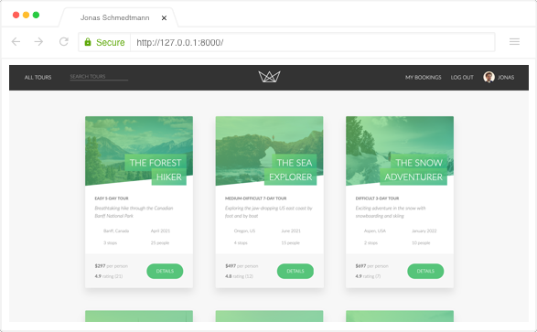













FRONT-END AND BACK-END
FRONT-END
BACK-END
WEB SERVER
HTTP
Server
BROWSER
App
DATABASE
Files
BACK-END STACK
FRONT-END STACK

Slide 14


FRONT-END AND BACK-END
STATIC
BROWSER
JavaScript ≠ Dynamic
SERVER-SIDE RENDERING
DYNAMIC
GET DATA
BUILD WEBSITE
DATABASE
BROWSER
T
TEMPLATE
TEMPLAE
Web application = Dynamic website + Functionality

